Slide 1

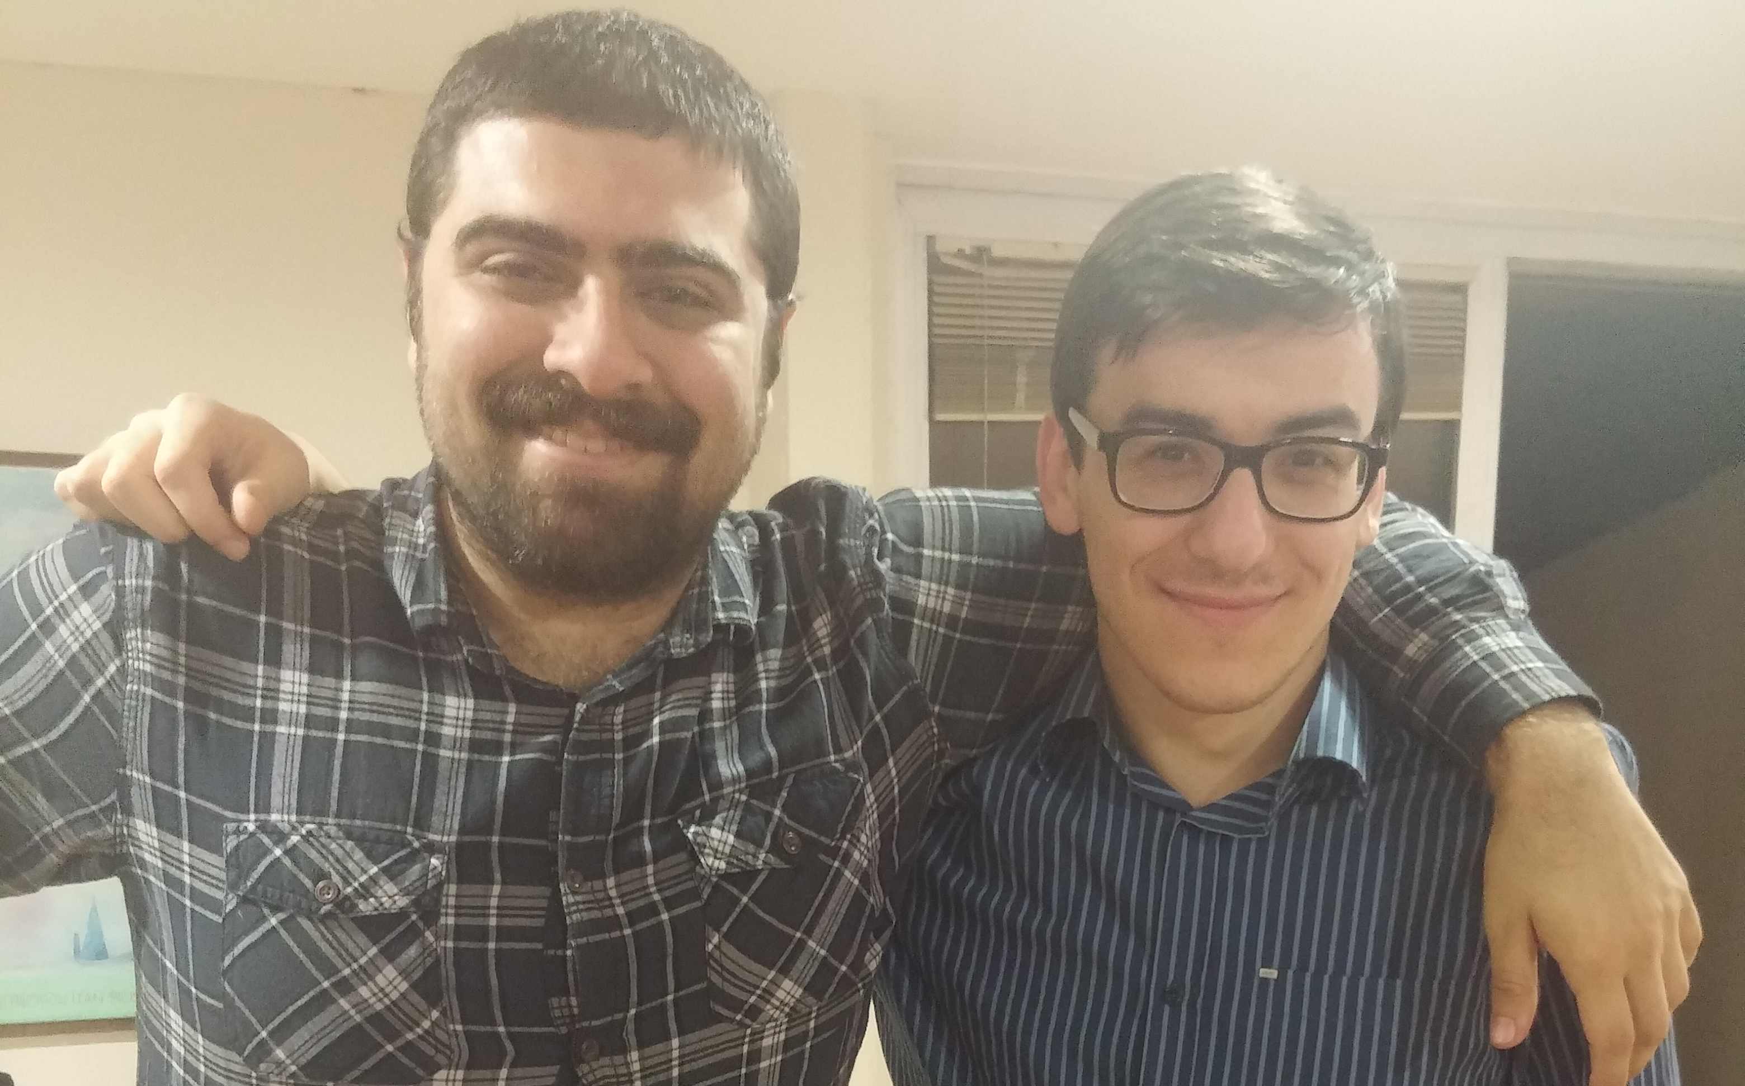


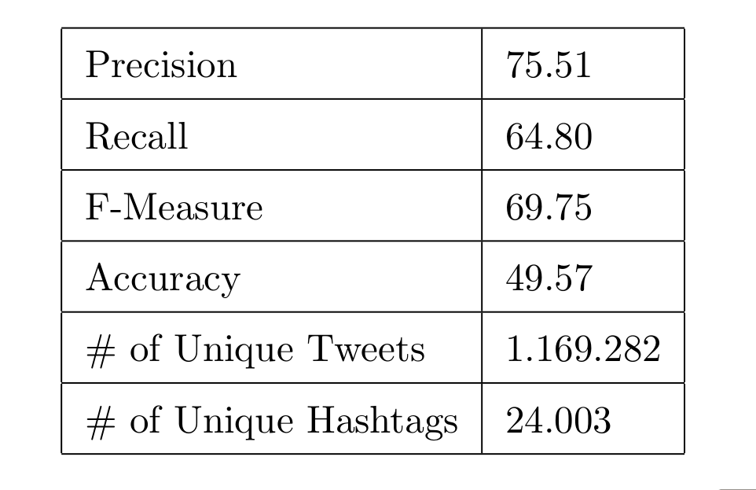
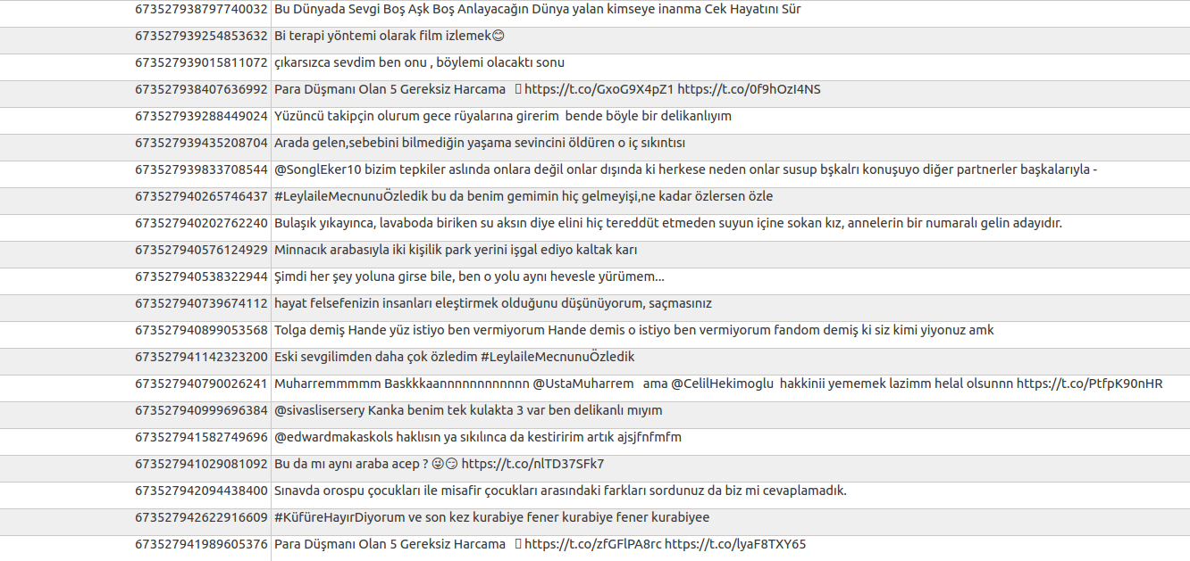
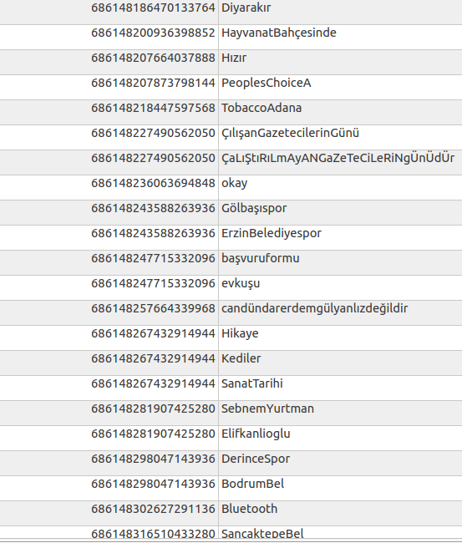
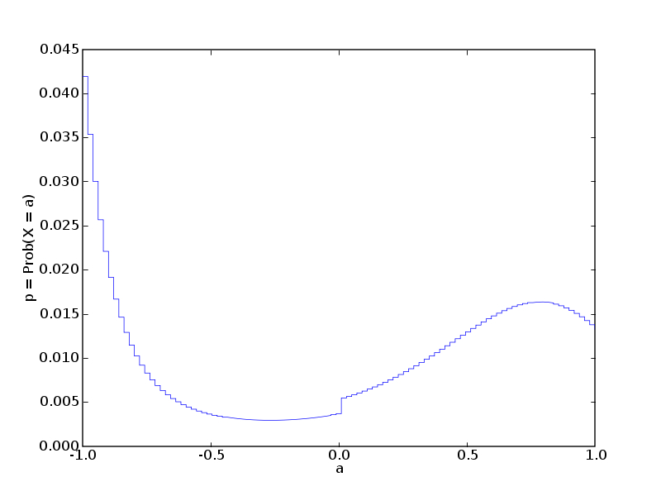
Hashtag Segmentation of Conversational Tweets in Turkish
Utku SARIDEDE Şevket TOPUZ
Advisor: Arzucan ÖZGÜR
Introduction and Motivation
Execution Processes of Application
Motivation:
Twitter is the latest social networking tool which affects everything related to the person. A hashtag is defined by any string prefixed with a “#”. It is a type of label or metadata letters.
Targets:
Creating corpus with Turkish tweets.
Implementing an application to segment hashtags into meaningful words.
Test
In order to create test data, we get 1000 random hashtags from our database.
We separated words manually.
Finally, we have one original test data and one manually separated test data.
Used our model to segment original test data.
Store them together.
Calculated precision, recall, f-measure and accuracy.
Training Features
Training Features
The Way of Implementation
• m1: It has current and next two characters as lower case. It includes ”@” in the case of out of bounds.
• m2: It has current and next two characters as no lower or uppercase action. It includes ”@” in the case of out
of bounds.
• m3: It checks current and next two characters. It writes ”x” for lowercase, ”X” for uppercase and ”@” for out
of bounds situation.
• m4: It checks previous, current and next characters. It writes ”x” for lowercase, ”X” for uppercase and ”@”
for out of bounds situation.
Manually Segmented
Application Results
Hayat Mucizelere Gebe
Seni Seviyorum Çünkü
bir poşet dolusu abur cubur
Hayat Mucizelere Gebe
Seni Seviyorum Çünkü
bir poşetdolusua burcu bur
Example
Result
#HiçMi
H B m1=hiç m2=Hiç m3=Xxx m4=@Xx
i I m1=içm m2=içM m3=xxX m4=Xxx
ç I m1=çmi m2=çMi m3=xXx m4=xxX
M B m1=mi@ m2=Mi@ m3=Xx@ m4=xXx
i I m1=i@@ m2=i@@ m3=x@@ m4=Xx@
Creating Turkish Corpus
Turkish tweets gathered from Twitter.
Hashtag rules were implemented.
Hashtags and texts were extracted from tweets.
Stored unique hashtags and texts in database.
Maximum Entropy Model
Future Works
Vocabulary of corpus feature can be added.
More than four letter feature can be added.
The size of corpus can be extended.
The irrelevant data can be removed from corpus.
The tweets which contain foreign words as hashtags can be removed.
More efficient application can be developed.
The target of statistical modeling is to construct a model that fits best accounts for training data. More specifically, for given training data, we have probability distribution We want to build a model that is close to training probability as possible.
We have used ”Maximum Entropy Model”
to decide boundaries of words.
We created Model with training data
via maximum-entropy model.
Special Thanks
Arzucan Özgür
Arda Çelebi
Mert Cem Taşdemir

